Slide 1
Spark Project
Overview of the project
In This Project I tried to analyze the apache access log file
I processed the log files using spark and I came out with the following outputs:
Top 5 IP Addresses/Hosts That has Accessed the server more than 10 times.
Getting number of logs per date ordered by the largest number of logs.
Getting Number of status codes of that appears in the log ordered by largest number

Slide 2
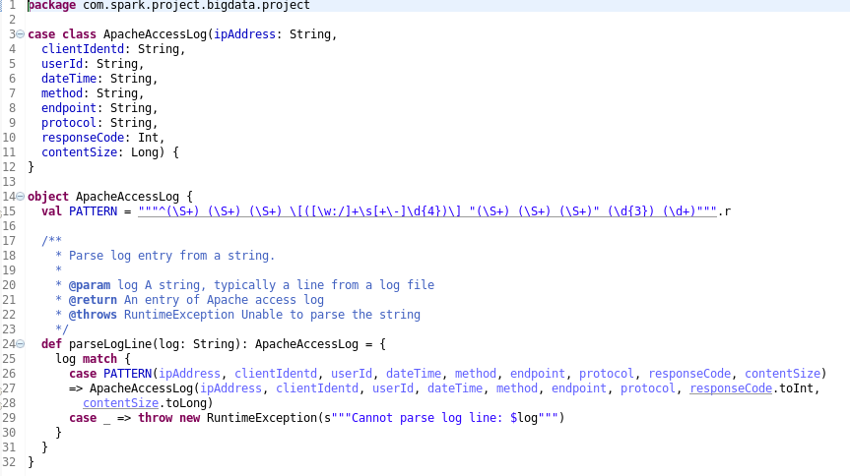
ApacheAccessLog Class
This class working as a parser of the access log file as shown

Slide 3
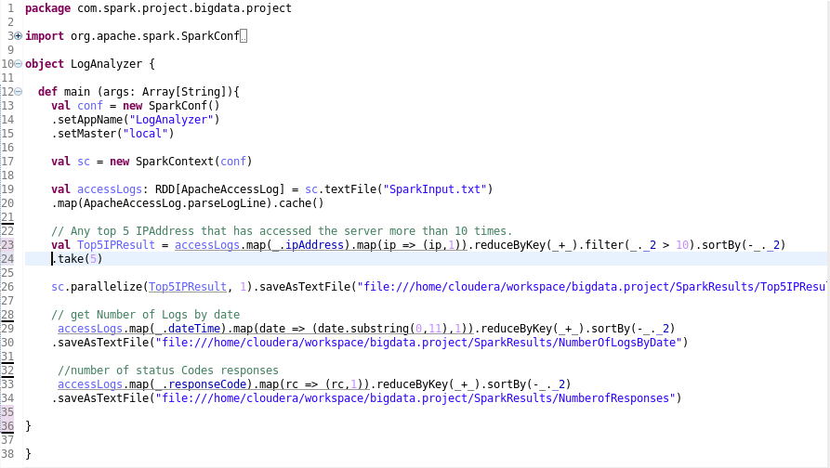
LogAnalyzer Class
This class has the main method and through it we generate the results

Slide 4

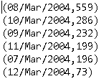

Spark Project Results
Top 5 IP Address has Accessed The Server | Number Of Logs By Date | Number Of Status Codes

